Slide 1
Node.JS Global
Command Line Tools. Debugging. Error Handling.

Slide 2
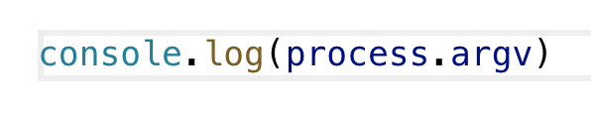
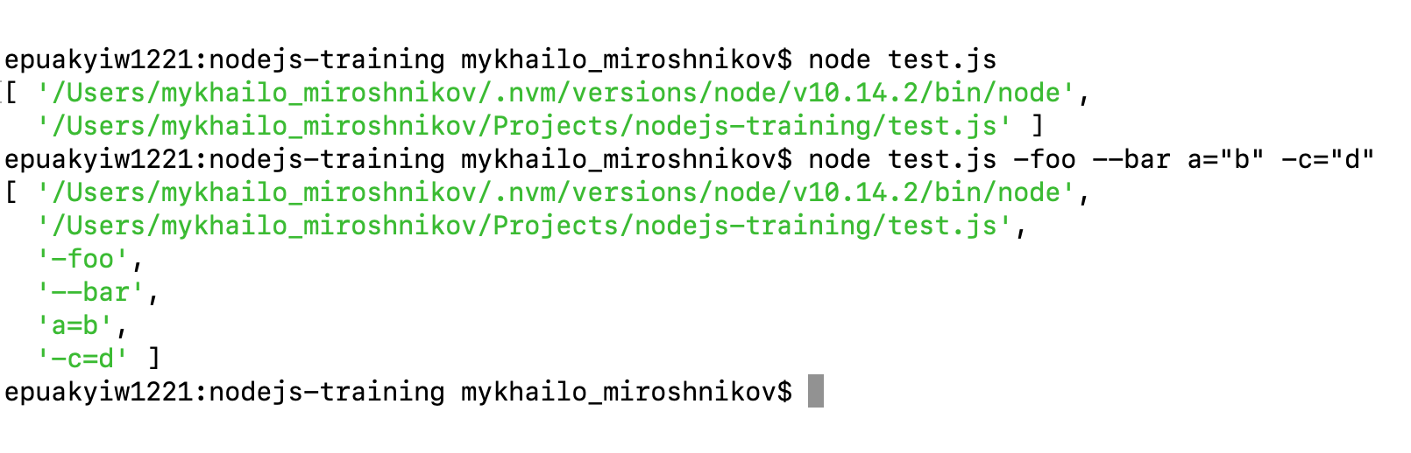
CLI Tools in Node.JS: process.argv
We need them to create custom command-line interfaces.
Main point of integration - process.argv

Slide 3
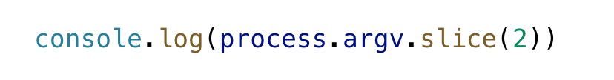
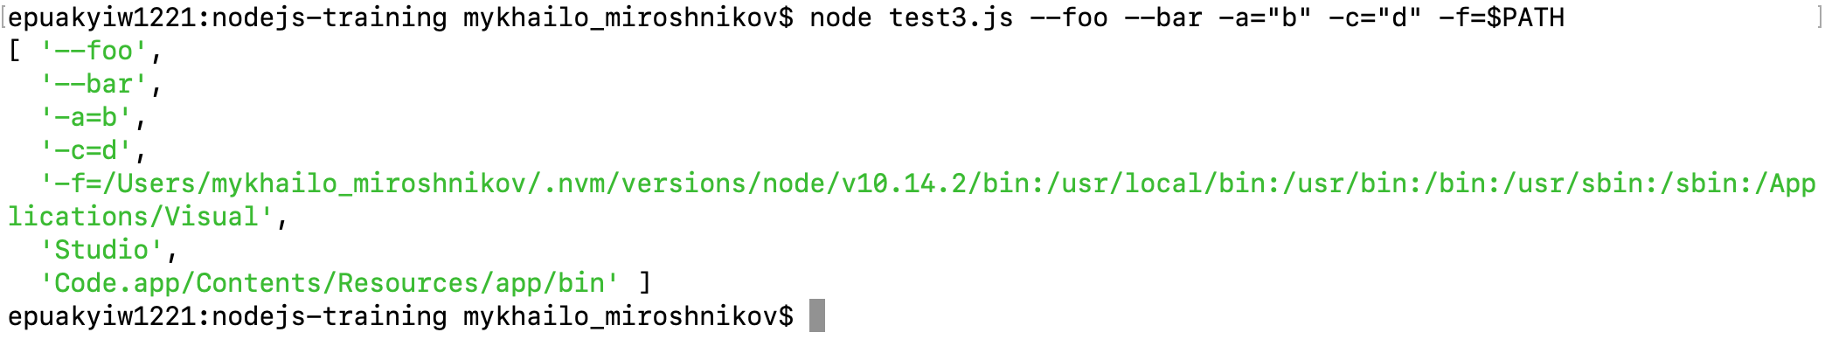
process.argv: slice it!

Slide 4
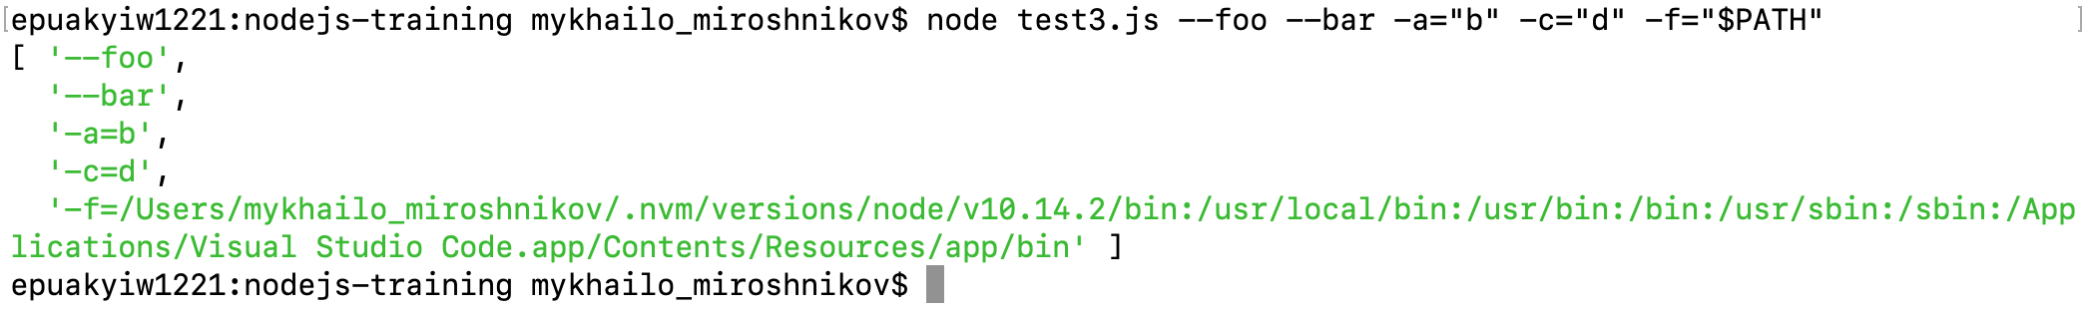
process.argv: wrap it!
Wrap variables in quotes to avoid corruption:

Slide 5
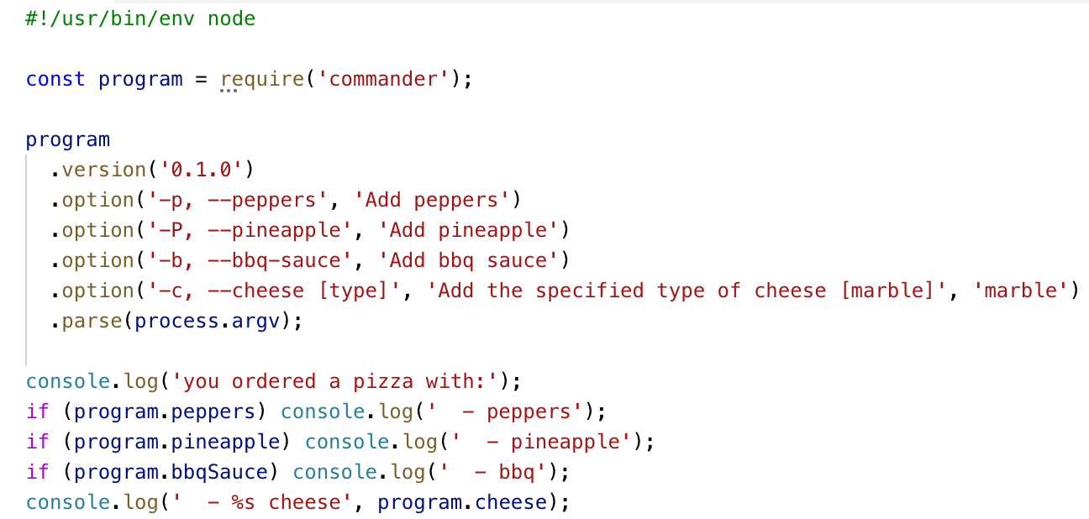
NPM CLI Packages
commander
13K+ stars on GitHub
aliases
negating
camel-casing
descriptions
etc.

Slide 6
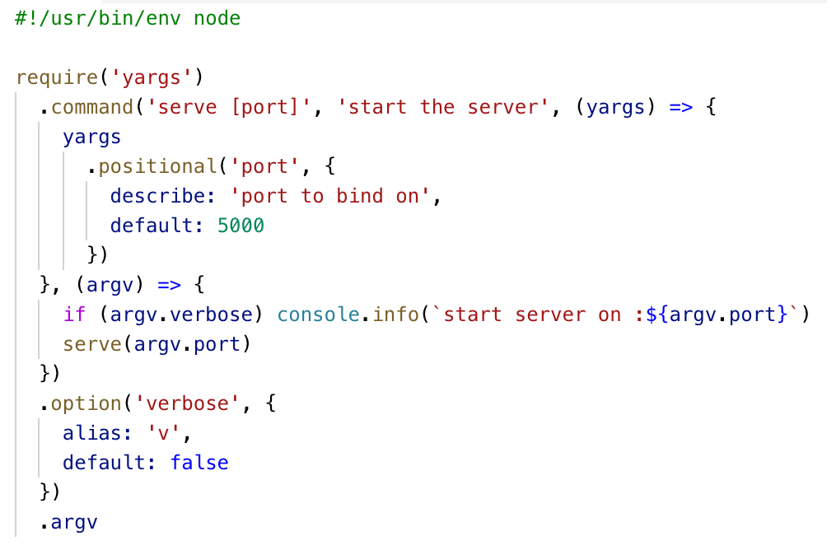
NPM CLI Packages
yargs
5.5K+ stars on GitHub
aliases
descriptions
etc.

Slide 8
ENV Variables
Rule #0: Don’t modify environment variables

Slide 9
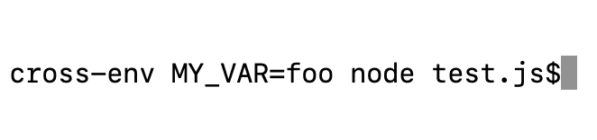
Cross-platform ENV variables
Use cross-env package to be able to reuse your CLI scripts on different platforms.
Only UNIX terminals support raw env variables.

Slide 10
Node.JS REPL - Read-Evaluate-Print Loop
Allows to evaluate JavaScript on-the-fly (sometimes useful)
Core modules don’t need to be require()’ed (useful)
Supports autocomplete (useful)
Supports different commands (mostly, useless)

Slide 11
require(‘repl’)
Supports custom commands (somewhat useful)
Global scope can be accessed/configured from both REPL environment and host process by using REPLServer.context (very useful)
Supports custom input/output streams - be it a server, DB, file or just a custom stream (very very useful)

Slide 12
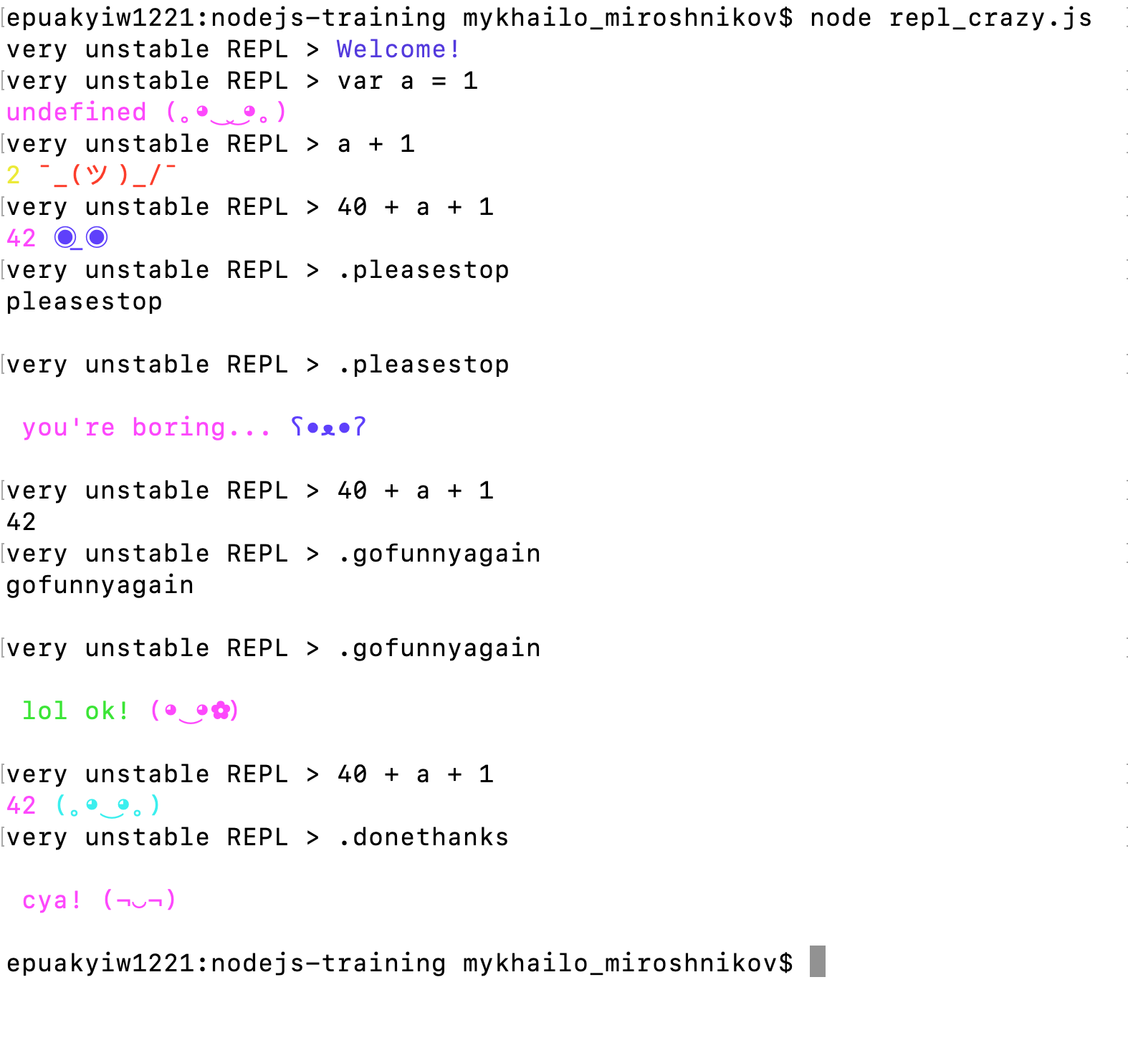
Create your custom REPL
Create your own REPL with the help of core require(‘repl’) module
It supports various configuration options, up to the point of ultimate customization of experience.

Slide 13
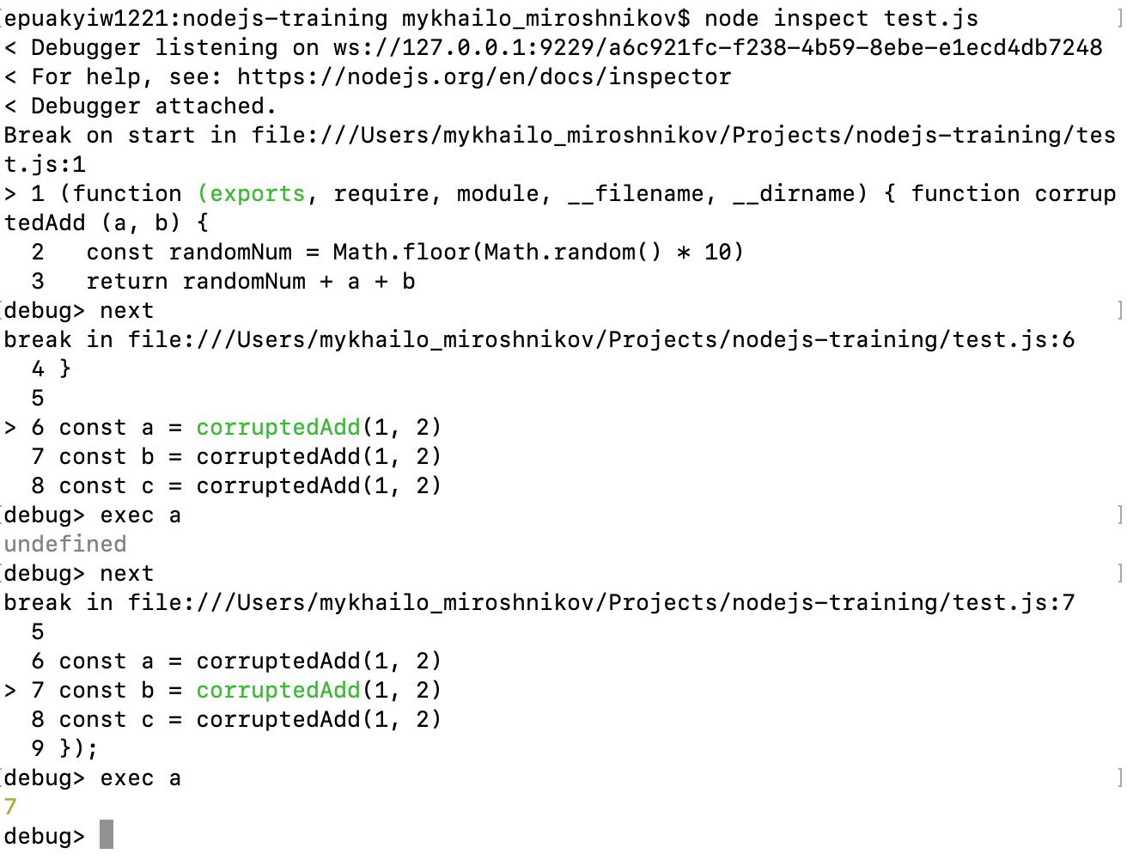
Debugging: REPL
node inspect %file%
Provides REPL for debugging
Has a number of useful commands
Almost never used, unless there’s no way to run in Chrome

Slide 14
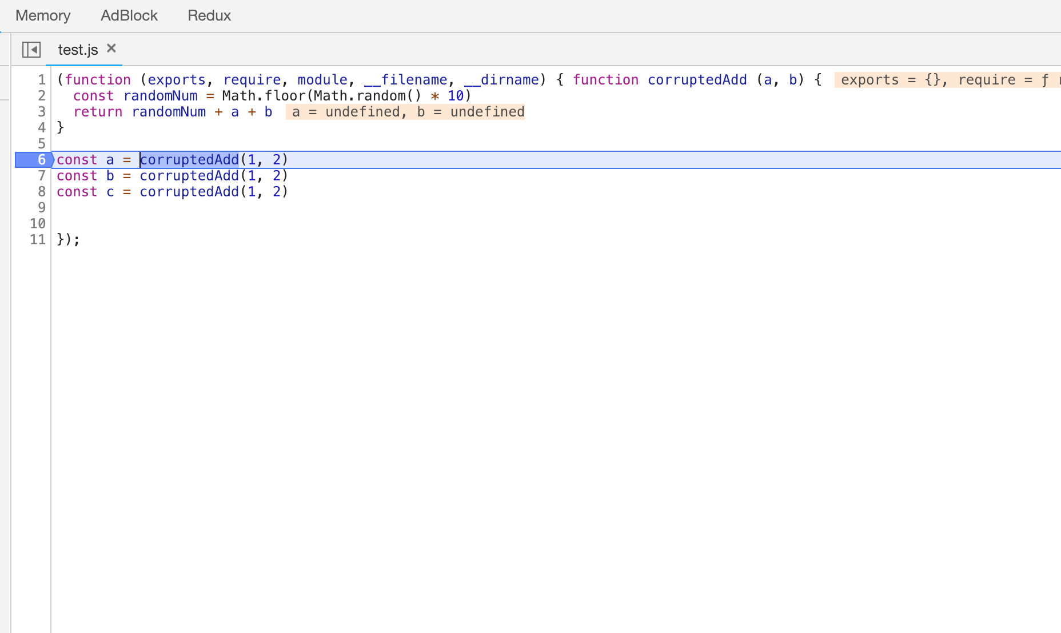
Debugging: Chrome
node --inspect-brk %file%
chrome://inspect
Allows to debug in Chrome

Slide 15
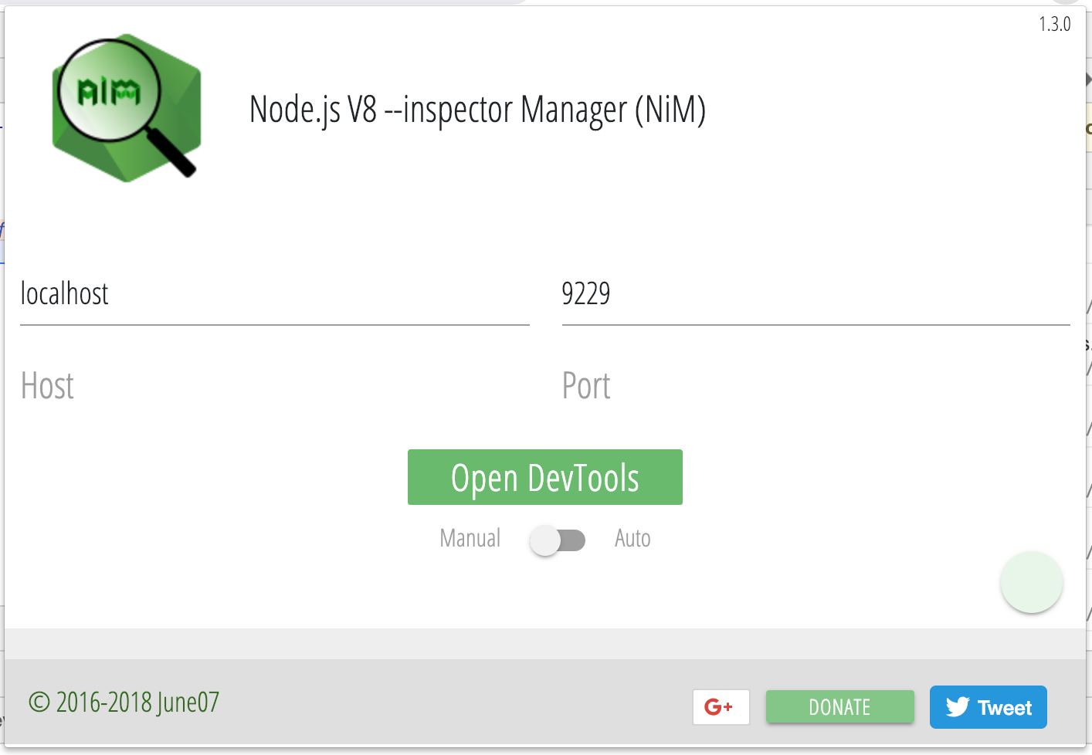
Debugging: Chrome
To improve experience, you can install Node Inspector Manager extension for Chrome (will open debugger page as soon as inspector in started)

Slide 16
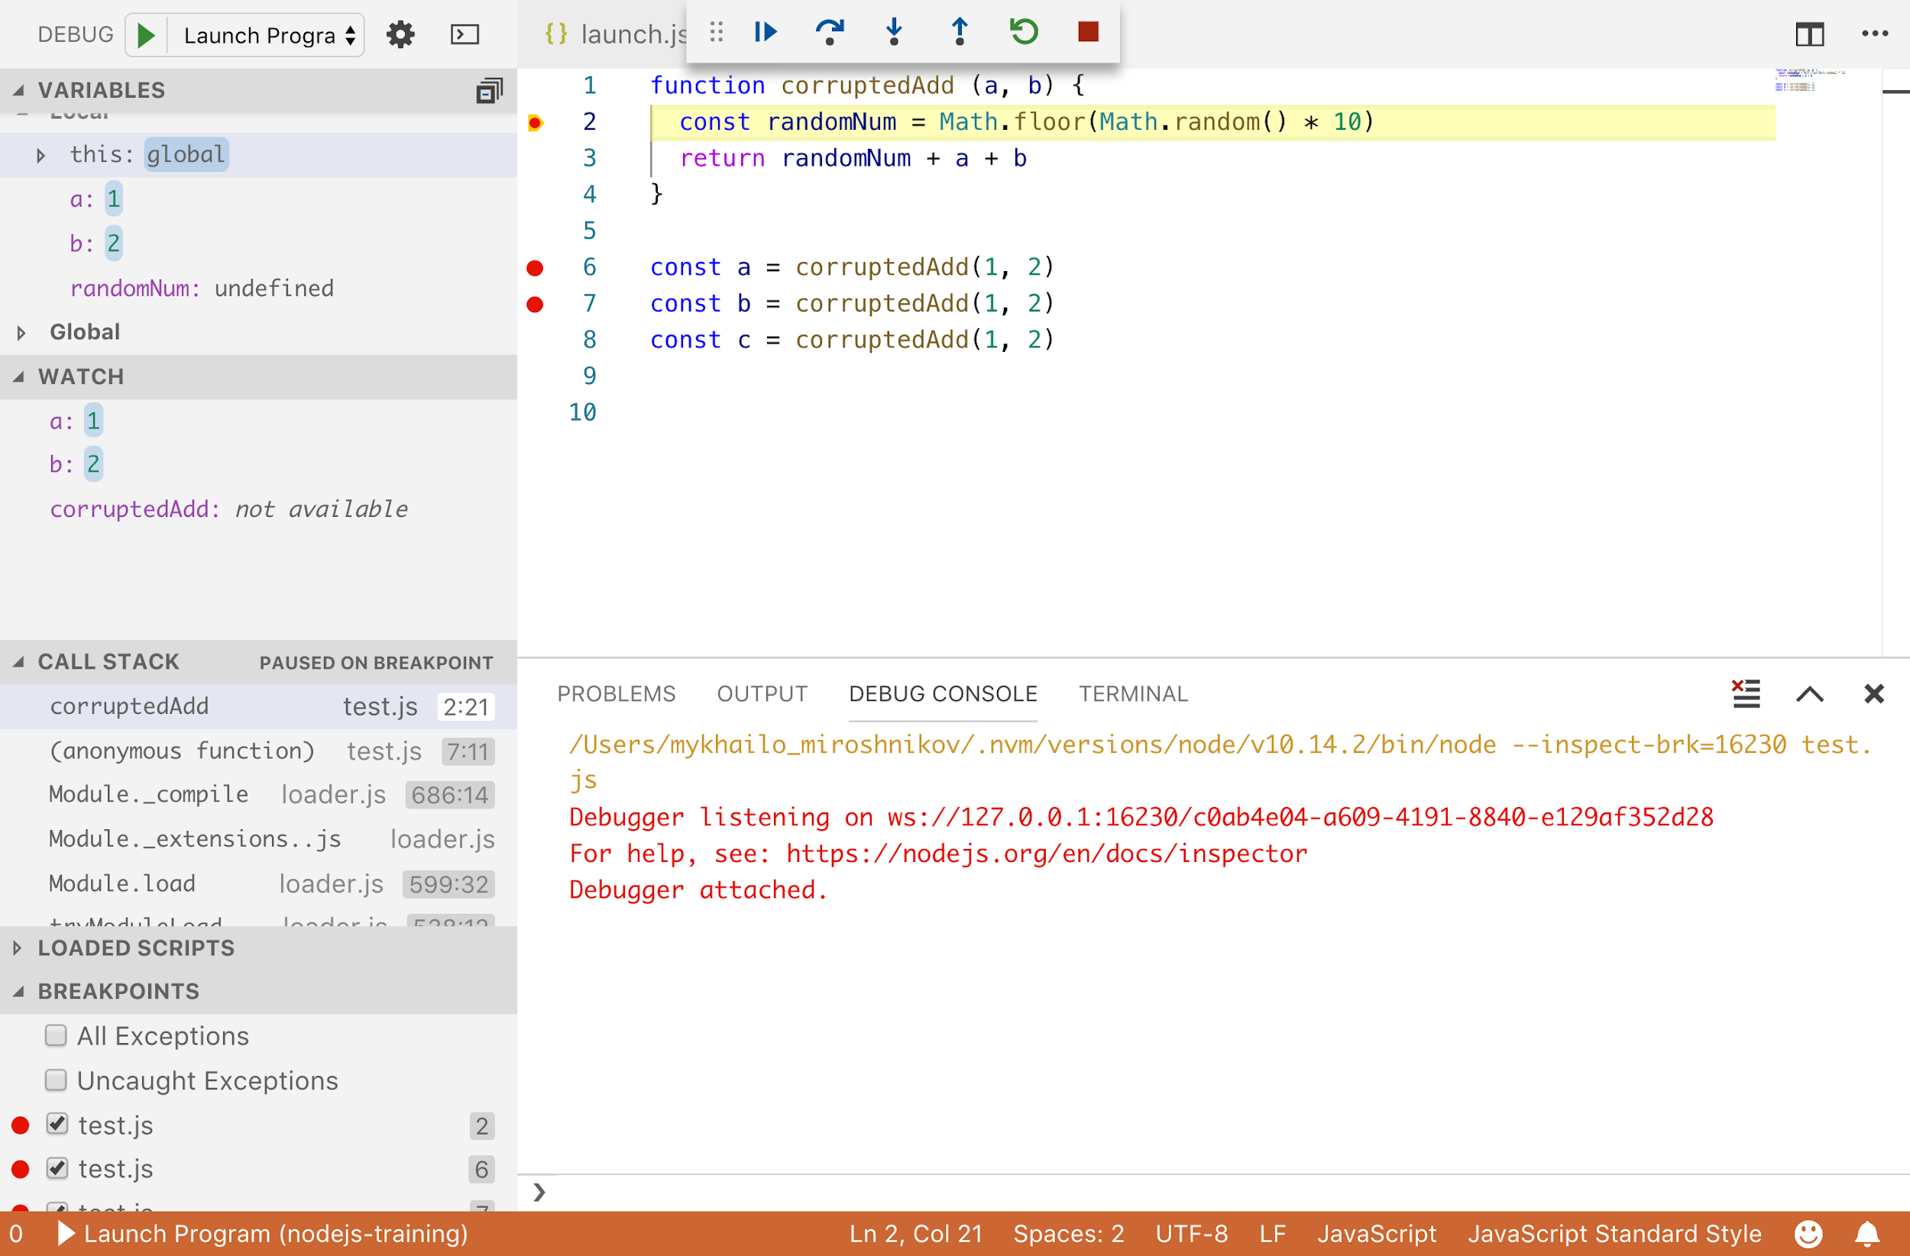

Debugging: VSCode
Configure launch.json
Press F5

Slide 17
Debugging: Remote
Set up SSH tunnel:
ssh –N –i -L 9229:127.0.0.1:9229
Set a message to target Node.js process to open debug port:
kill –SIGUSR1 %node_app_id%
Connect with Chrome Dev Tools
BE VERY CAREFUL WITH PRODUCTION SERVERS

Slide 18
Handling Errors: How
throw/try/catch/finally - rethrow when needed, no empty catch()
Promise.catch
async/await try/catch
error-first callbacks
EventEmitter errors
Optionally, create your own error types by extending from Error

Slide 19
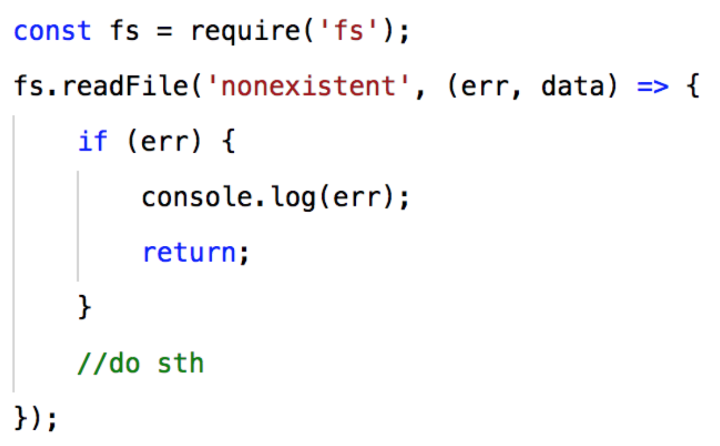
Handling Errors: Error-first callback
Common Node.JS approach to handle errors by propagating them up.

Slide 20
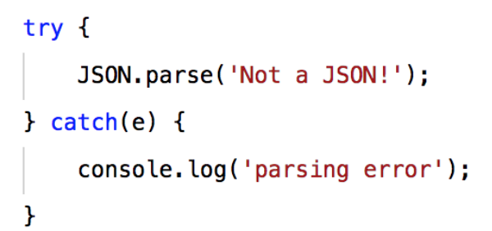
Handling Errors: Try/catch
Common way to handle synchronous errors.

Slide 21
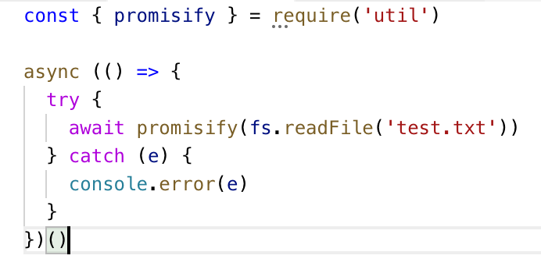
Handling Errors: Async try/catch
Latest way to handle asynchronous errors.

Slide 22
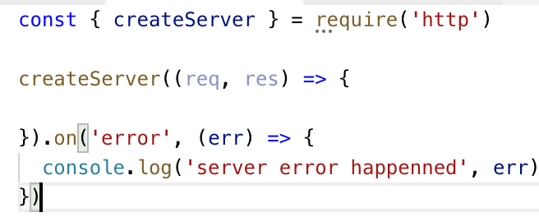
Handling Errors: EventEmitter errors
Just another way to handle error in Node.JS
To throw an error use EventEmitter.emit(‘error’, err)

Slide 23
Handling Errors: Common System Errors
EACCES - permission denied
EADDRINUSE - address already in use
ECONNREFUSED - connection refused
ENOENT – no such file or directory
etc.

Slide 24
Handling Errors: Uncaught exceptions
process.on(‘uncaughtException’)
process.on(unhandledRejection’)
DO NOT RESTORE THE PROGRAM TO NORMAL OPERATION
Log errors, free resources and process.exit(1)

Slide 25
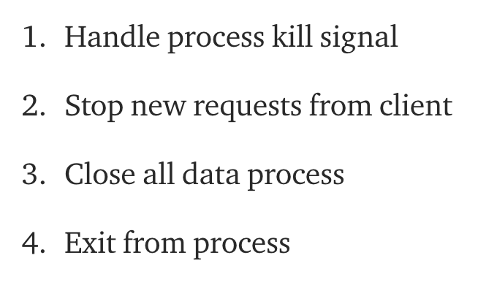
Handling Errors: Shutdown gracefully

Slide 26
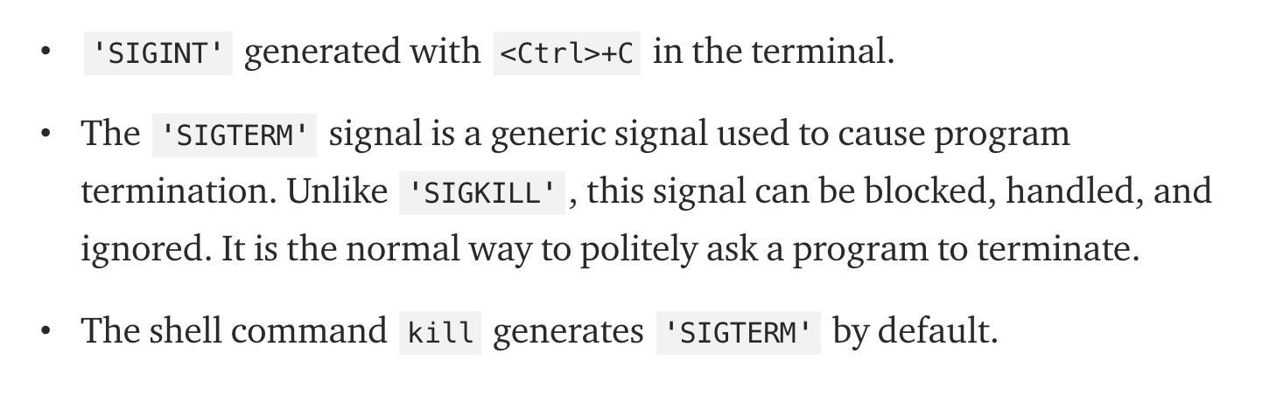
Graceful Shutdown: Listen for process kill signals

Slide 27
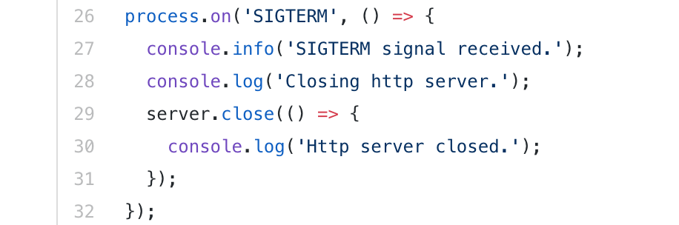
Graceful Shutdown: Stop listening to new clients

Slide 28
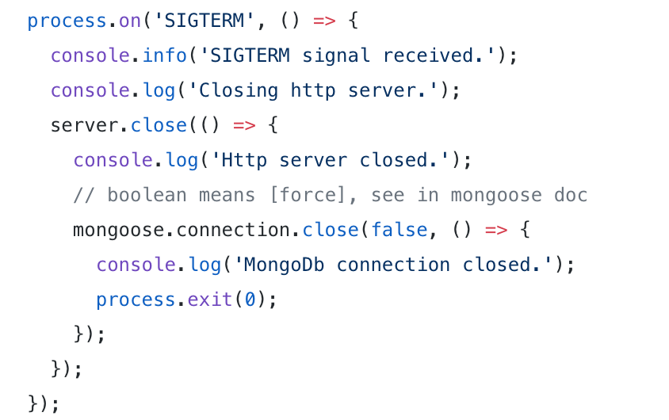
Graceful Shutdown: Free resources and exit process

Slide 29
Logging: What to collect
Errors
Debug info
Business stats (remember about GDPR)
Other metrics (e.g. performance)

Slide 30
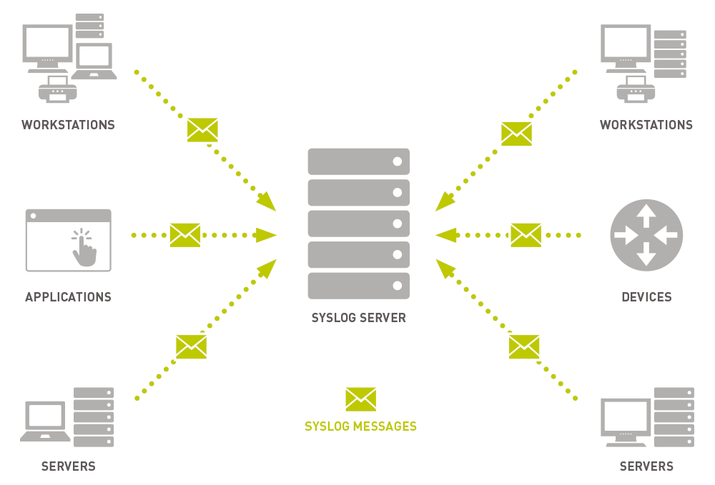
Logging: Syslog Protocol
The protocol by which logs are generated, transported and stored.

Slide 31
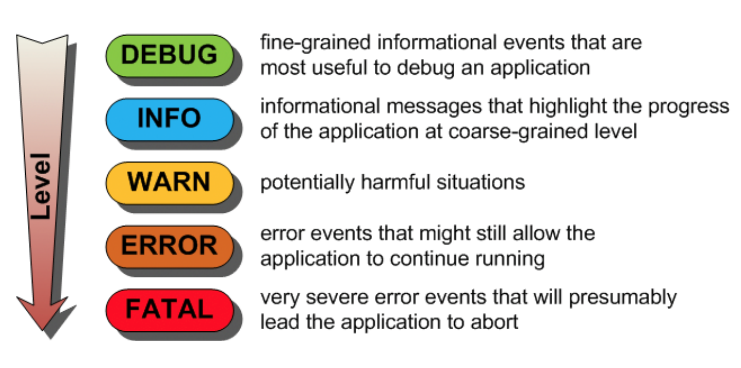
Logging: Levels
NPM Levels:
0: error 1: warn 2: info 3: verbose 4: debug 5: silly

Slide 32
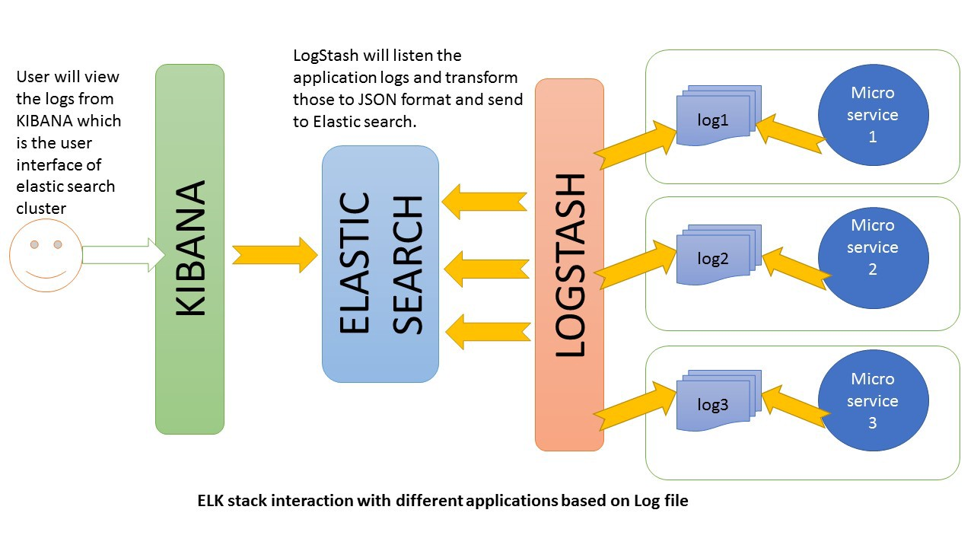
Logging: ELK Stack
Elasticsearch is a NoSQL database
Logstash is a log pipeline tool that accepts inputs from various sources
Kibana is a visualization layer that works on top of Elasticsearch

Slide 33
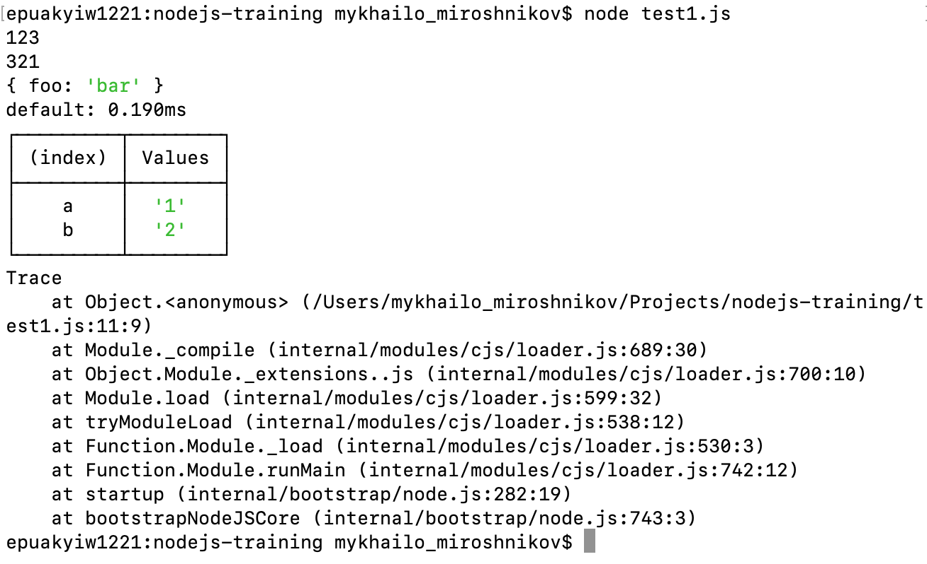
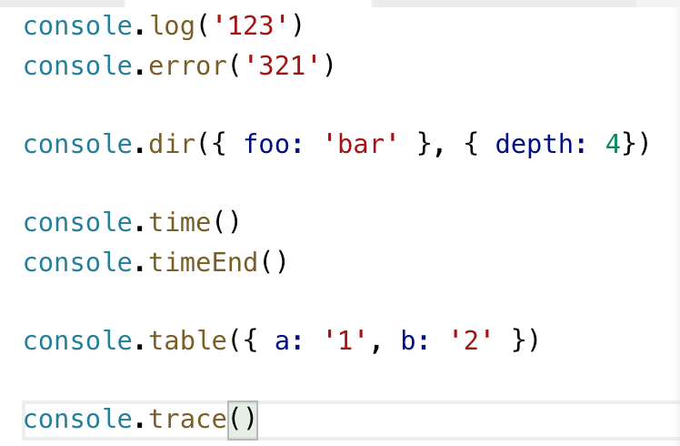
Logging: Console

Slide 34
Logging: Winston
Logging to, Console, Files, Databases
Logging levels
Timestamps
Configurable output
Log rotation
String/JSON

Slide 35
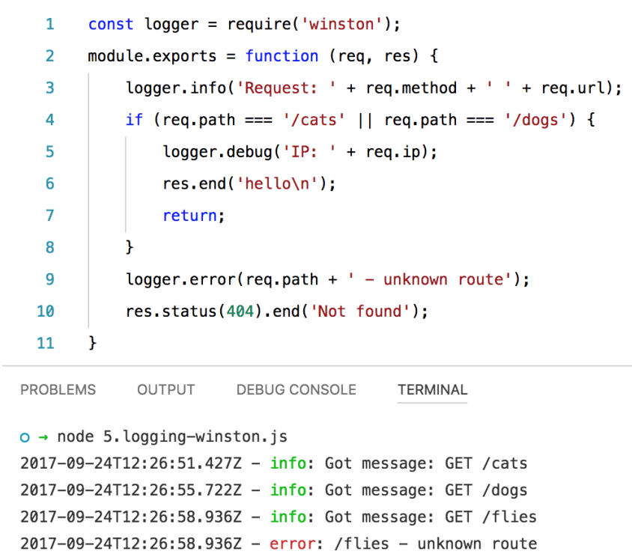
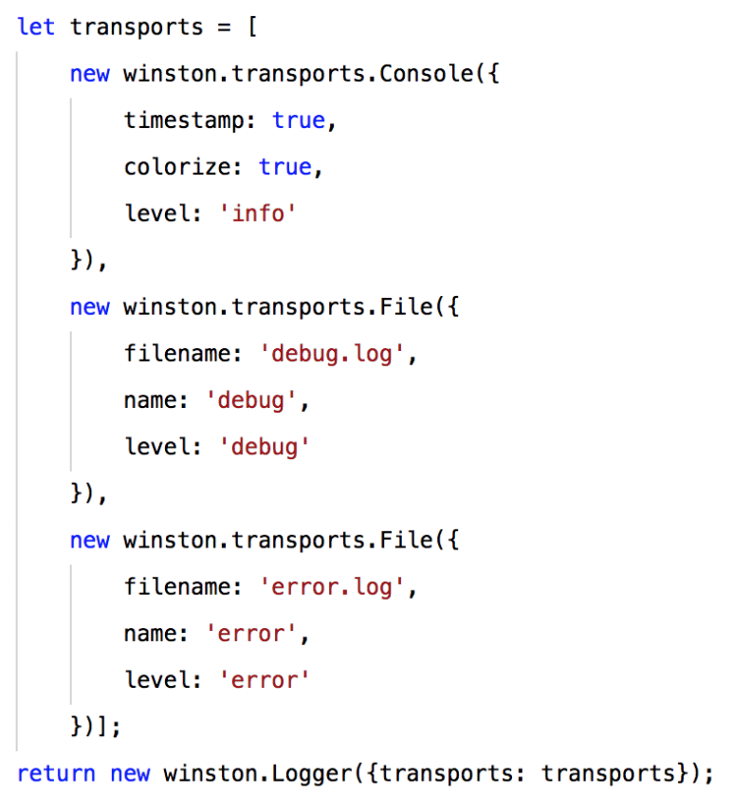
Logging: Winston

Slide 36
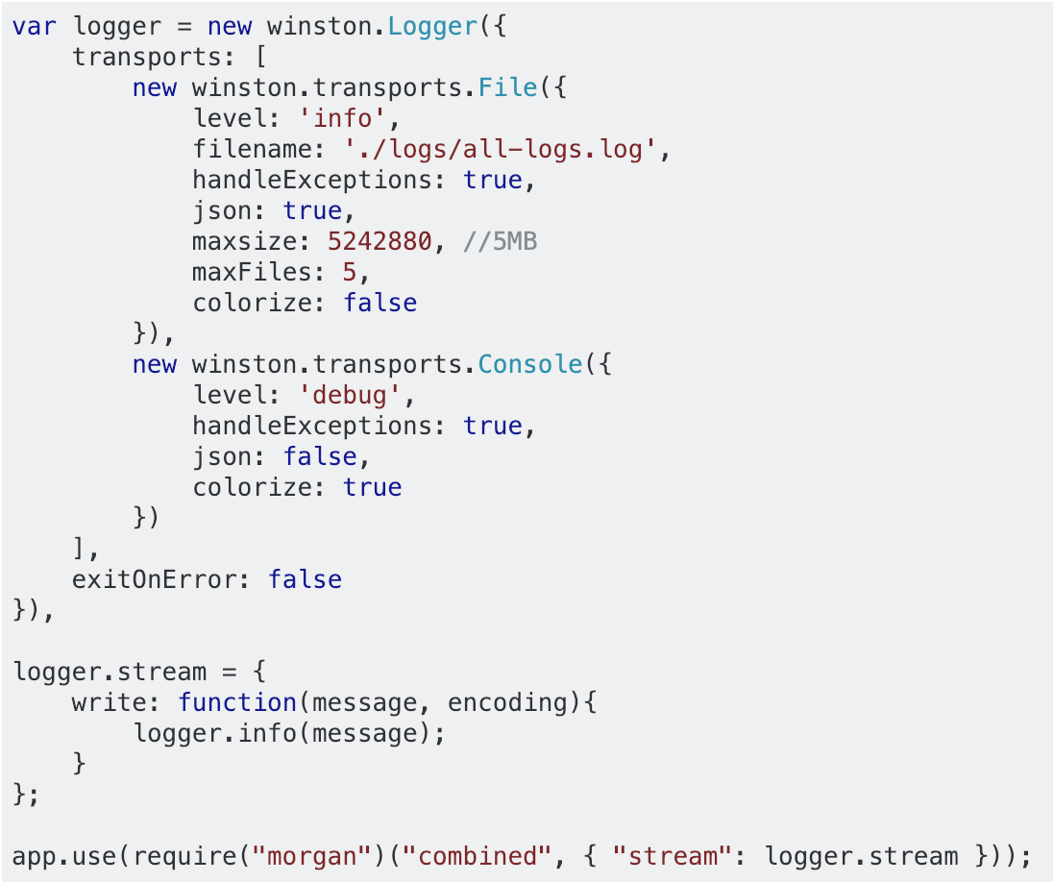
Logging: Ultimate
Combine Winston and Morgan to achieve the ultimate experience

